Slide 1
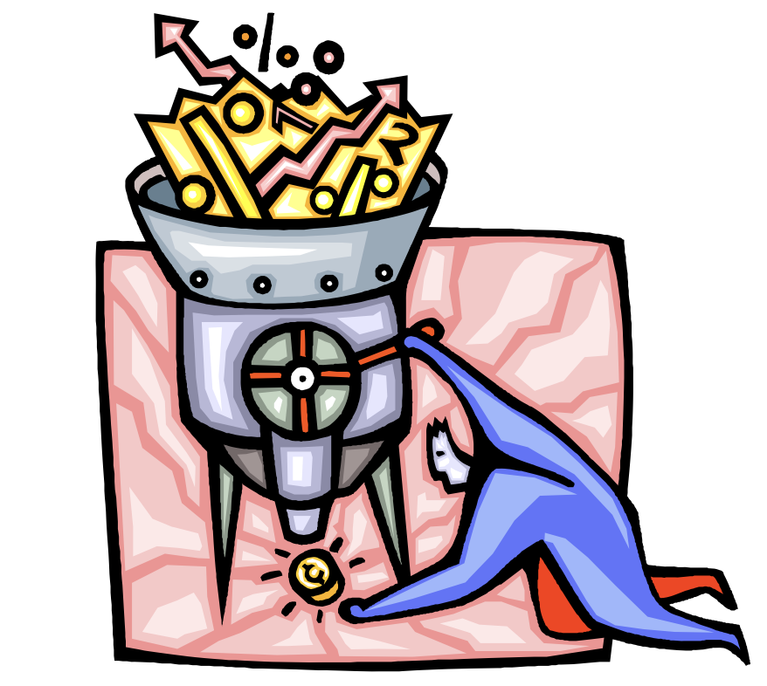
DATA 180
Introduction to Data Science

Slide 2
What is Data Science?
Data science is usually loosely defined as a collection of methods for managing and extracting information from data. It is an emerging field of study, with roots in statistics, economics, and computer science and draws heavily on techniques from these areas.
While not a comprehensive list, the most important topics in the field are generally considered to be:
Data Wrangling
Data Visualization
Statistical (Machine) Learning
Professional Ethics

Slide 3
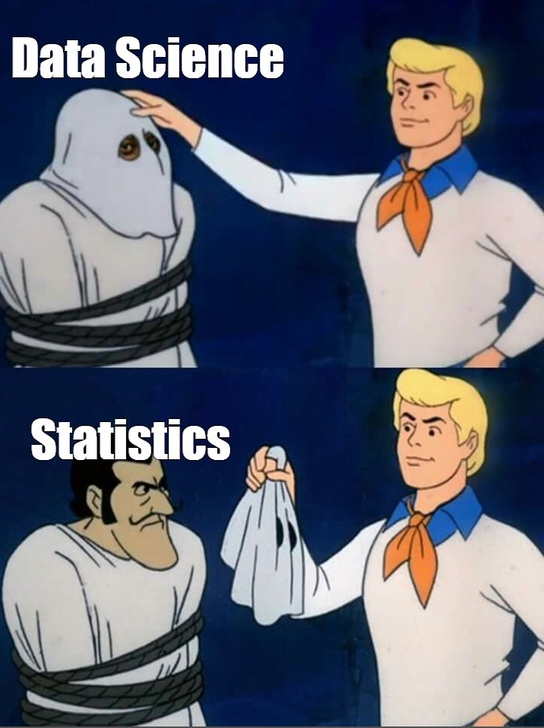

Slide 4
Data Wrangling
The term data wrangling (also sometimes called data munging) typically refers to a set of techniques for manipulating data in preparation of the application of downstream data science techniques.
It can include:
Data Retrieval, Aggregation, Merging, and Filtering
Web-scraping
Data Cleaning
Data Transformations
Some organizations employ data engineers whose primary job is to work upstream from data scientists to design, organize, and facilitate data pipelines.
How to store data?

Slide 5
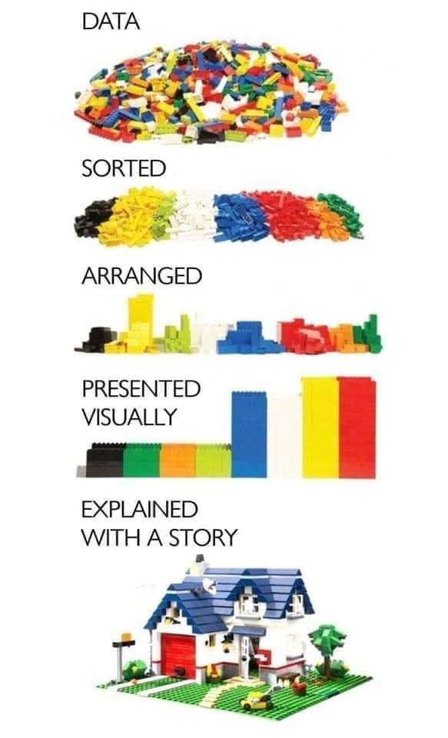

Slide 6
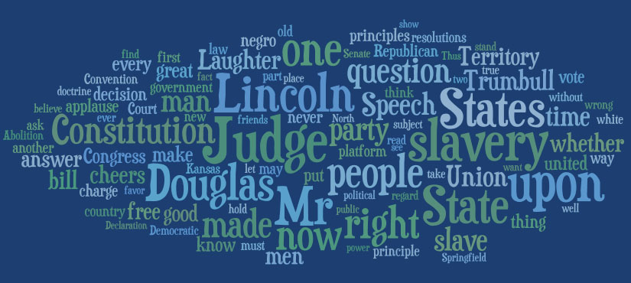
Data Visualization
Data visualization has been a staple in data analysis, with clear examples extending back into the 18th century (and earlier depending on the definition). Graphics activate sections of the brain in different ways than tables and charts, and visual processing is itself a rich and fascinating field.
The advent of modern computing and display technology has facilitated the production of visual expressions of data. In many cases graphics are now becoming dynamic and interactive.
“The greatest value of a picture is when it forces us to notice what we never expected to see.” –J. Tukey
http://housedivided.dickinson.edu/sites/lincoln/clickable-word-clouds/

Slide 7
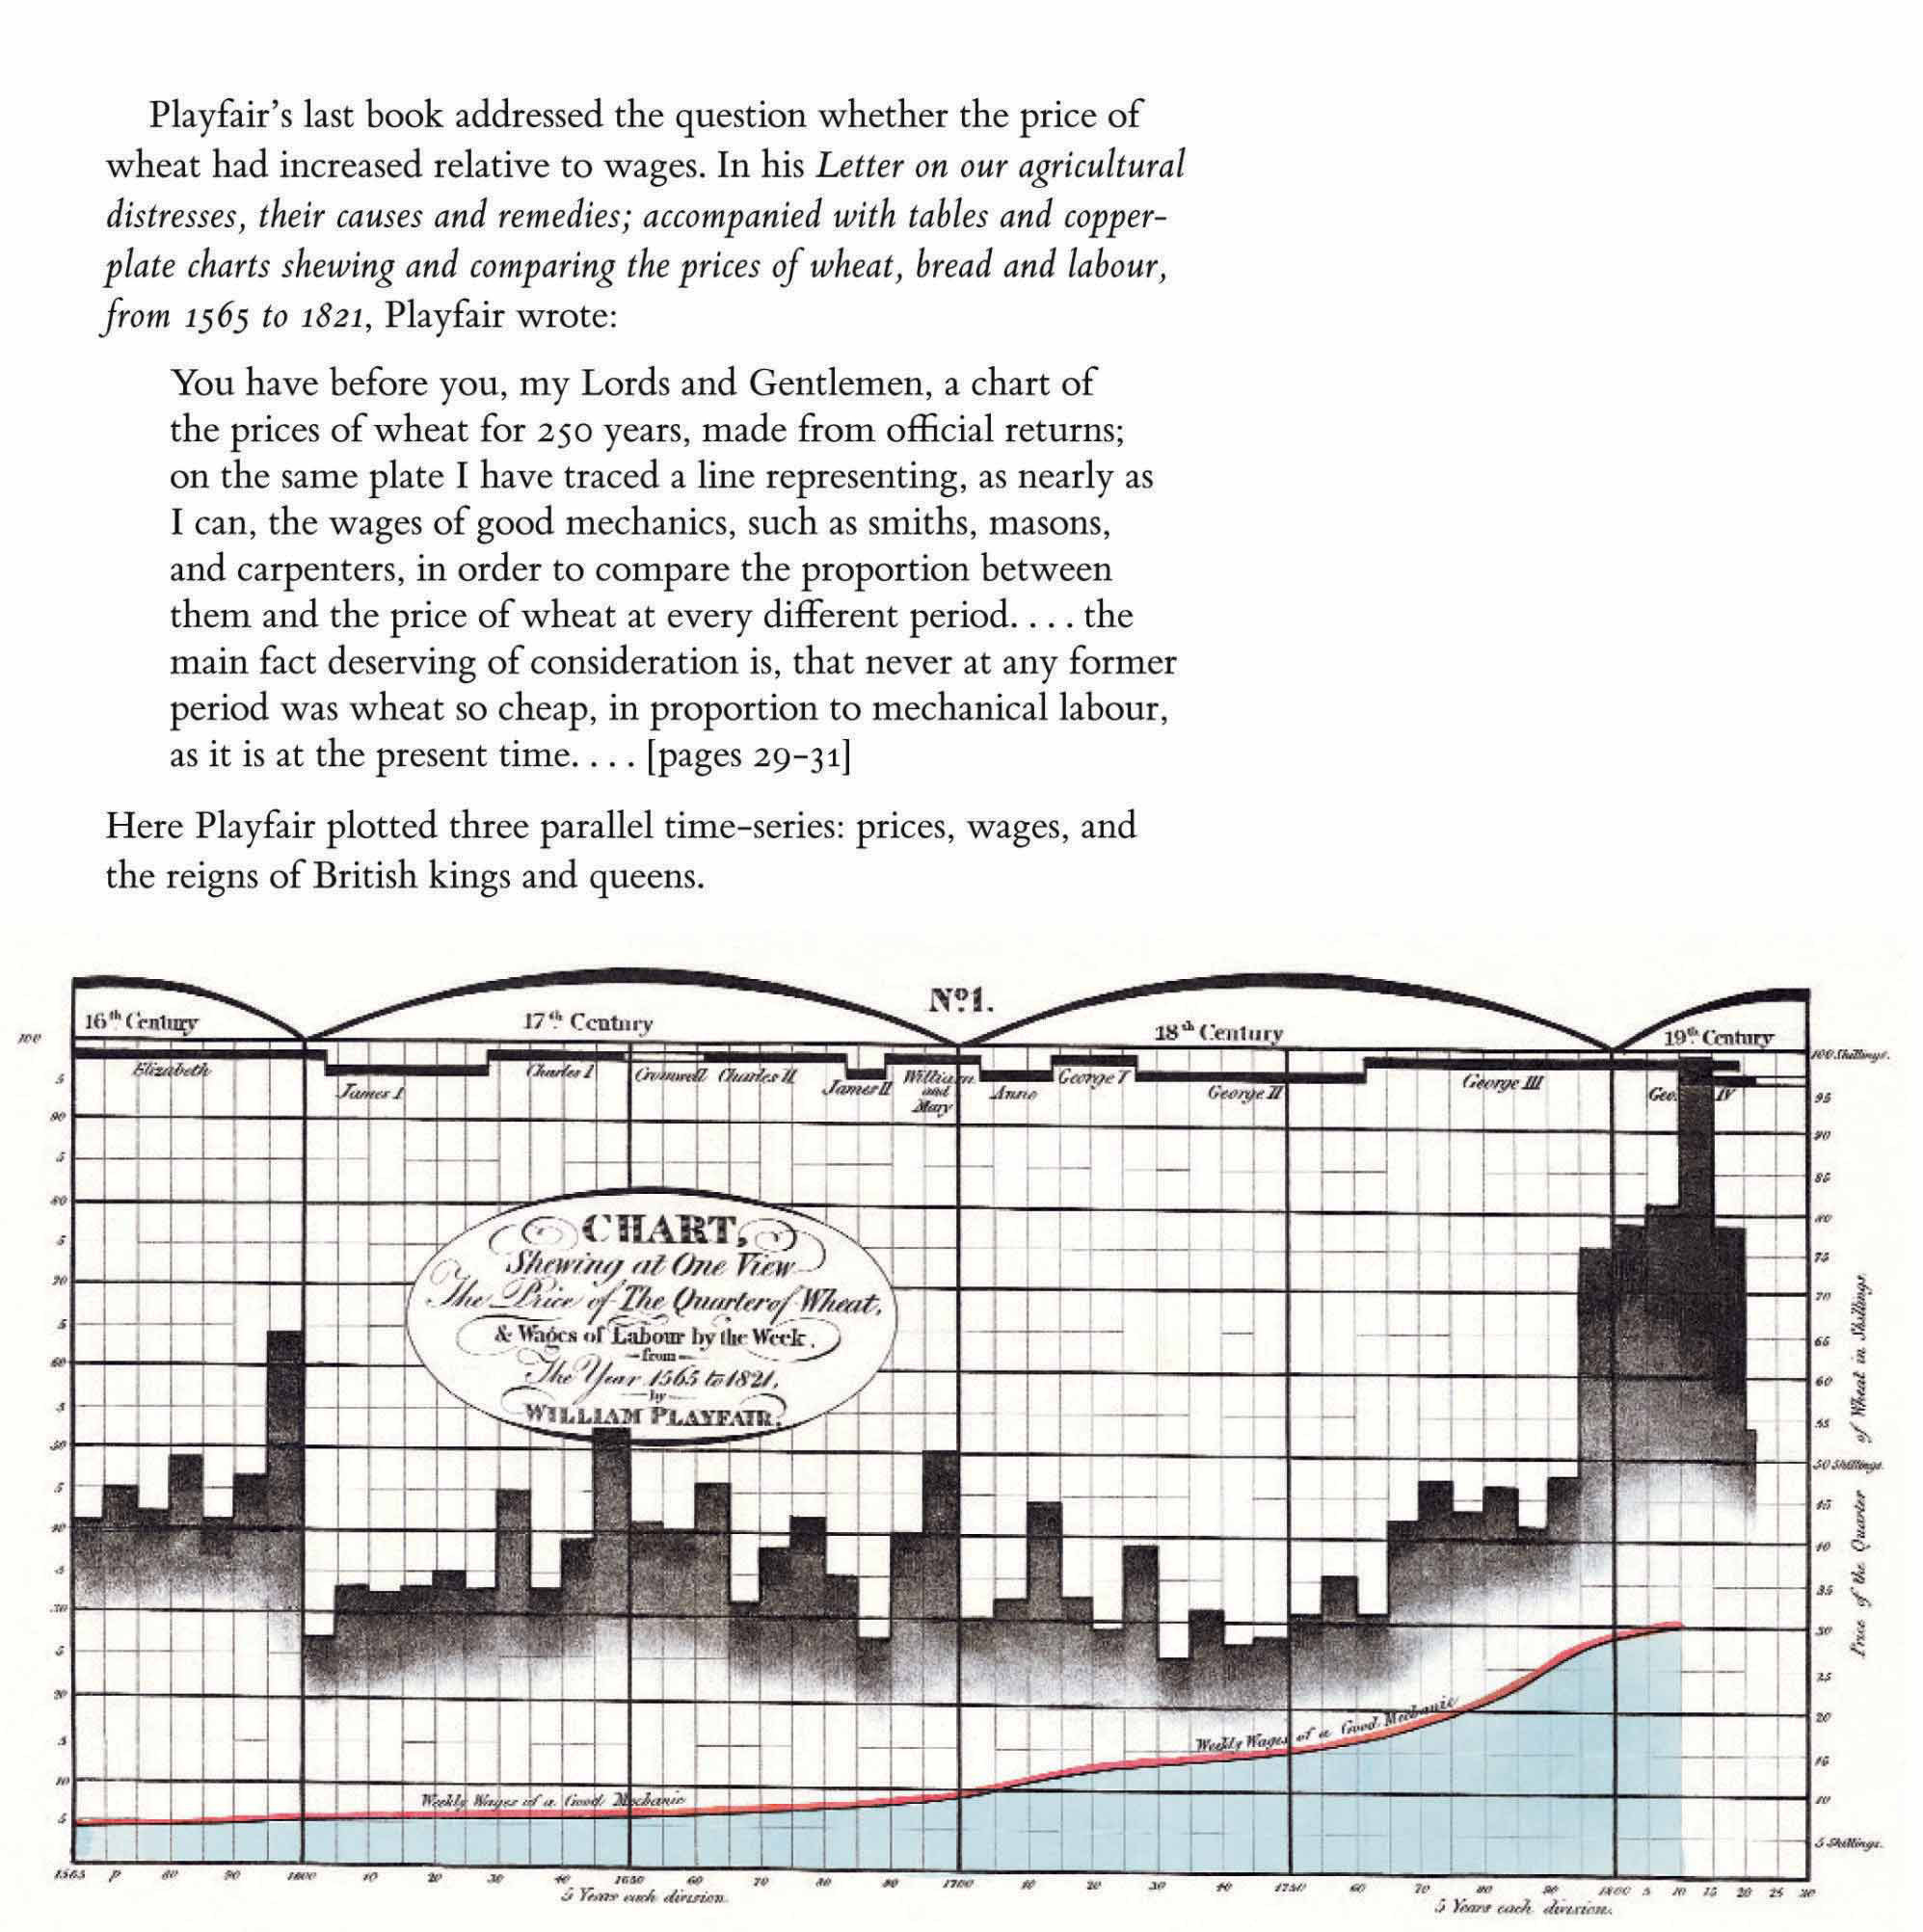

Slide 8
Overview of Statistical Learning
Broadly speaking, statistical learning falls into two categories:
Supervised Learning
Observations are classified into predictor and response variables
Primary goal is model relationships between the predictor and response variables
Relationships can be used for prediction or for inference
Unsupervised Learning
Each observation is a vector of variables, but they are not classified as predictors and responses
Primary goal is to find structure in the multivariable data set
One important technique is clustering, which seeks to find distinct groups of units or variables in the data set

Slide 9
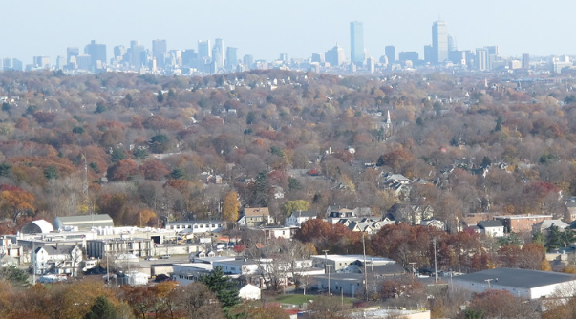
Supervised Learning: Boston Example
Below is a portion of the Boston data set:
crim zn indus chas nox rm age dis rad tax ptratio medv
1 0.00632 18 2.31 0 0.538 6.575 65.2 4.0900 1 296 15.3 24.0
2 0.02731 0 7.07 0 0.469 6.421 78.9 4.9671 2 242 17.8 21.6
3 0.02729 0 7.07 0 0.469 7.185 61.1 4.9671 2 242 17.8 34.7
4 0.03237 0 2.18 0 0.458 6.998 45.8 6.0622 3 222 18.7 33.4
5 0.06905 0 2.18 0 0.458 7.147 54.2 6.0622 3 222 18.7 36.2
6 0.02985 0 2.18 0 0.458 6.430 58.7 6.0622 3 222 18.7 28.7
Variables:
crim: per capita crime rate by town.
zn: proportion of residential land zoned for lots over 25,000 sq.ft.
indus: proportion of non-retail business acres per town.
chas: Charles River dummy variable (= 1 if tract bounds river; 0 otherwise).
nox: nitrogen oxides concentration (parts per 10 million).
rm: average number of rooms per dwelling.
age: proportion of owner-occupied units built prior to 1940.
dis: weighted mean of distances to five Boston employment centers.
rad: index of accessibility to radial highways.
tax: full-value property-tax rate per \$10,000.
ptratio: pupil-teacher ratio by town.
medv: median value of owner-occupied homes in \$1000s
Bill Damon Flickr

Slide 10
Supervised Learning: Boston Example
We may wish to construct a model that predicts median value (mdev) based on the other variables in the data set.
This assigns medv as the response variable and the other variables as predictor variables.
This model could be used to predict future (or unobserved) responses based on the predictors
If we built a new suburb with a set of predictors, what would the model predict to be the median value of homes in the new suburb?
Some models can also be used for inference to understand the relationship between the response and the predictors.
If we reduced the pollution level in a particular suburb by half its current amount, what would the effect be on median values?
If we added access to the radial highways, what would the model estimate the effect to be the median value of homes in the suburb?

Slide 11
Unsupervised Learning: MammalsMilk Example
Below is a portion of the MammalsMilk data set:
Mammal | Water | Protein | Fat | Lactose | Ash
Horse | 90.1 | 2.6 | 1 | 6.9 | 0.35
Orangutan | 88.5 | 1.4 | 3.5 | 6 | 0.24
Monkey | 88.4 | 2.2 | 2.7 | 6.4 | 0.18
Donkey | 90.3 | 1.7 | 1.4 | 6.2 | 0.4
Hippo | 90.4 | 0.6 | 4.5 | 4.4 | 0.1
Camel | 87.7 | 3.5 | 3.4 | 4.8 | 0.71
Bison | 86.9 | 4.8 | 1.7 | 5.7 | 0.9
Buffalo | 82.1 | 5.9 | 7.9 | 4.7 | 0.78
Guinea Pig | 81.9 | 7.4 | 7.2 | 2.7 | 0.85
Cat | 81.6 | 10.1 | 6.3 | 4.4 | 0.75
Fox | 81.6 | 6.6 | 5.9 | 4.9 | 0.93
Variables:
Water: percentage water
Protein: percentage of protein
Fat: percentage of fat
Lactose: percentage of lactose
Ash: percentage of ash (mineral content)
Each mammal produces a vector of milk components:
(Water, Protein, Fat, Lactose, Ash)
but we don’t have a natural candidate for a response variable.

Slide 12
Unsupervised Learning: MammalsMilk Example
While we don’t have a response variable we wish to predict, we can still ask questions about how the variables are related to each other or to the objects in our data set.
A natural question to ask is: Do the mammals in the data set form a natural collection of discrete groups based on the measurements from their milk?
For these groups (clusters) to be useful, we would expect
Individual clusters should display some level of homogeneity
Different clusters should display some level of separation
An important technique in unsupervised learning is cluster analysis, which provides a collections of methods for identifying, representing, and validating these internal groups.

Slide 13
Statistics
Many of the techniques in Data Science employ concepts from Descriptive and Inferential Statistics.
In order to properly contextualize these ideas, we will spend some time reviewing concepts from probability and the study of random variables.
We will also examine several numeric and graphical measures of important statistical properties including measures of
Center
Shape
Spread
Position

Slide 14
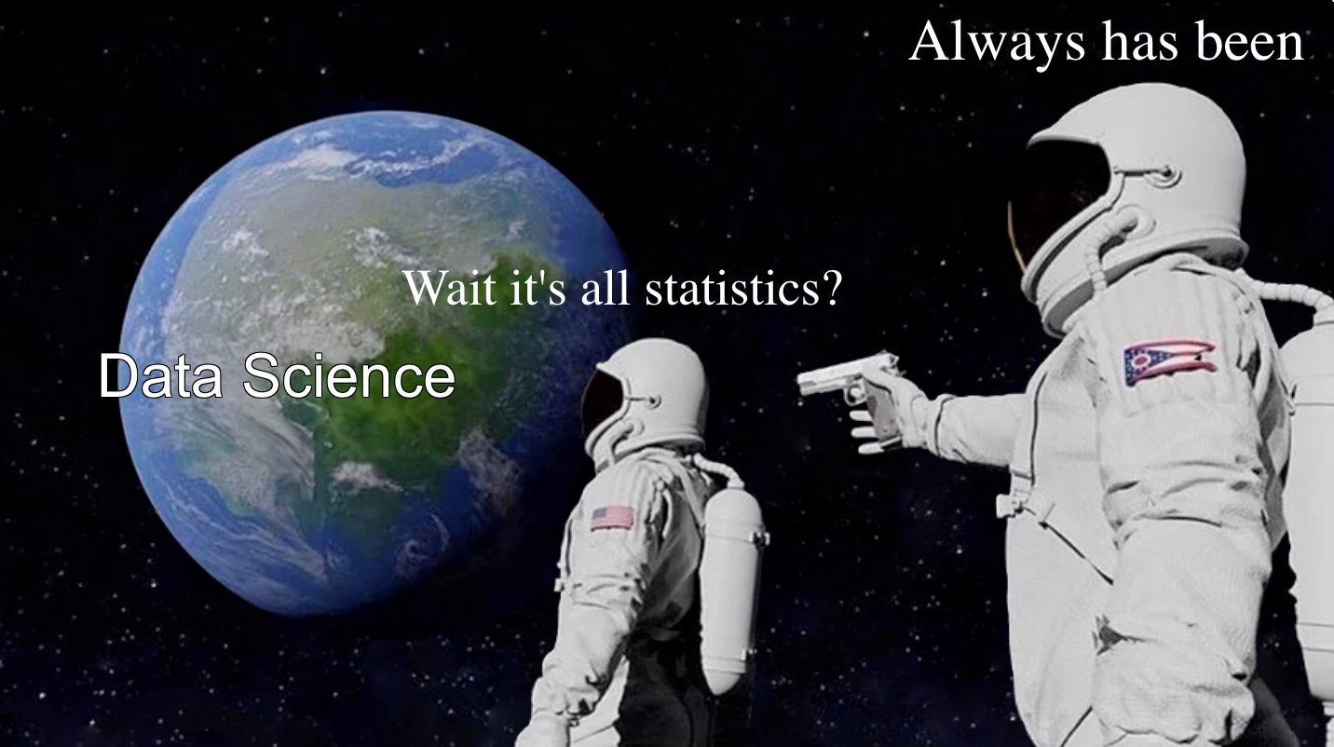

Slide 15
Professional Ethics
As our capabilities in data acquisition, retrieval, and processing increase, care needs to be exercised to assure that what institutions are doing with their data maintains ethical standards.
Capabilities change at a rate that is faster than legislative and corporate bodies can react to, and this creates a large “ethics gap” that opens up when legal and ethical boundaries separate.
It is important that the data analyst consider the ethical implications of the methods s/he employs and keep in mind that the things we can do are not necessarily in correspondence with the things we should do.
The analyst should be considered as a stakeholder in the discussion and should be expected to conduct their work following ethical guidelines.

Slide 16
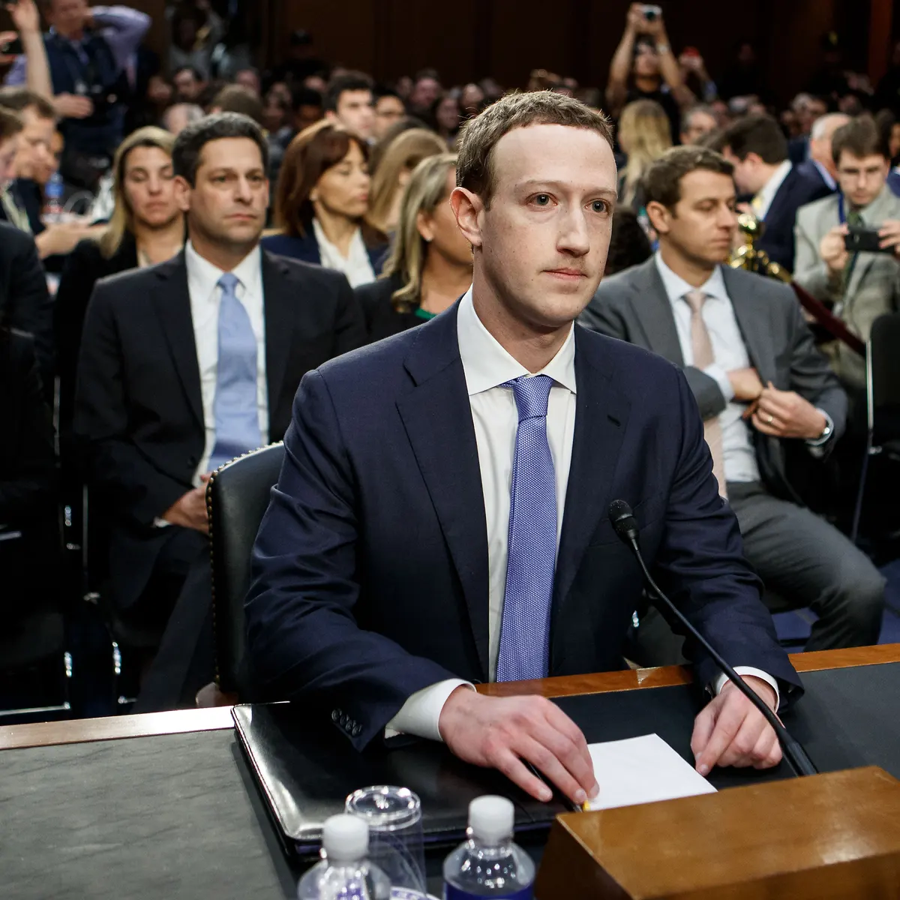
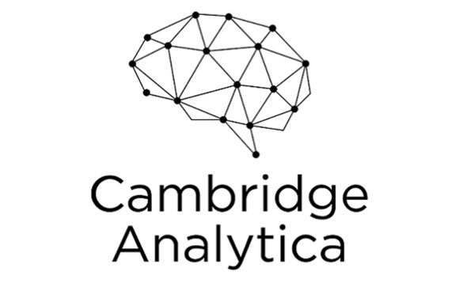
DATA 198: Philosophy of Data

Slide 17
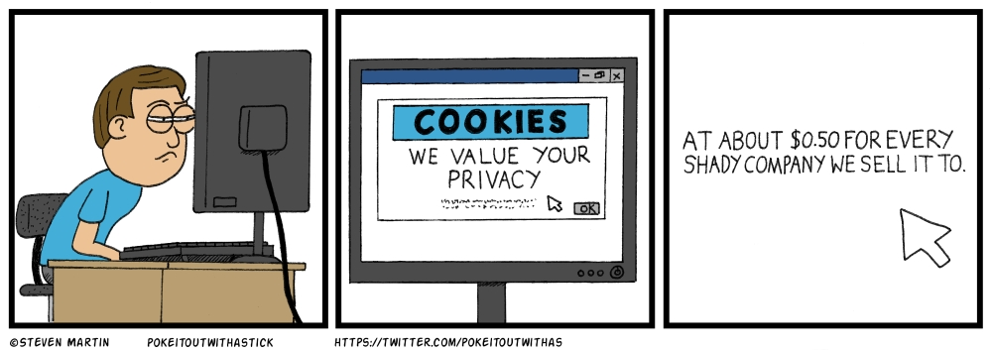

Slide 18

R and R-Studio
We will use the R Programming environment extensively during the course
R is a free software environment for statistical computing and graphics. It compiles and runs on a wide variety of UNIX platforms, Windows and MacOS.
R has an enormous user base and a wealth of open-source resources.
We will use R-Studio, which comes with base R + more
References to objects in R will usually be presented in the Courier New font for readability.
https://cran.rstudio.com
https://www.rstudio.com/products/rstudio/download

Slide 19
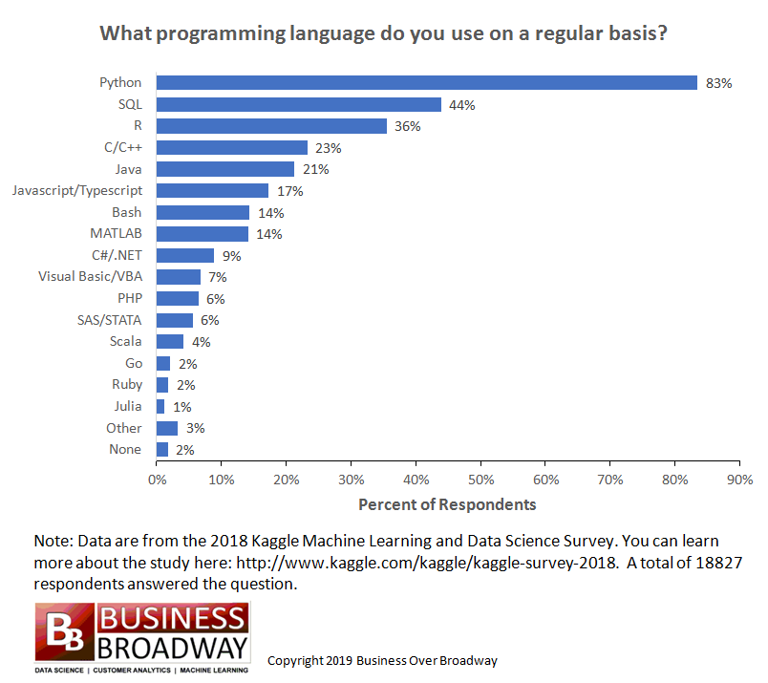

Slide 20
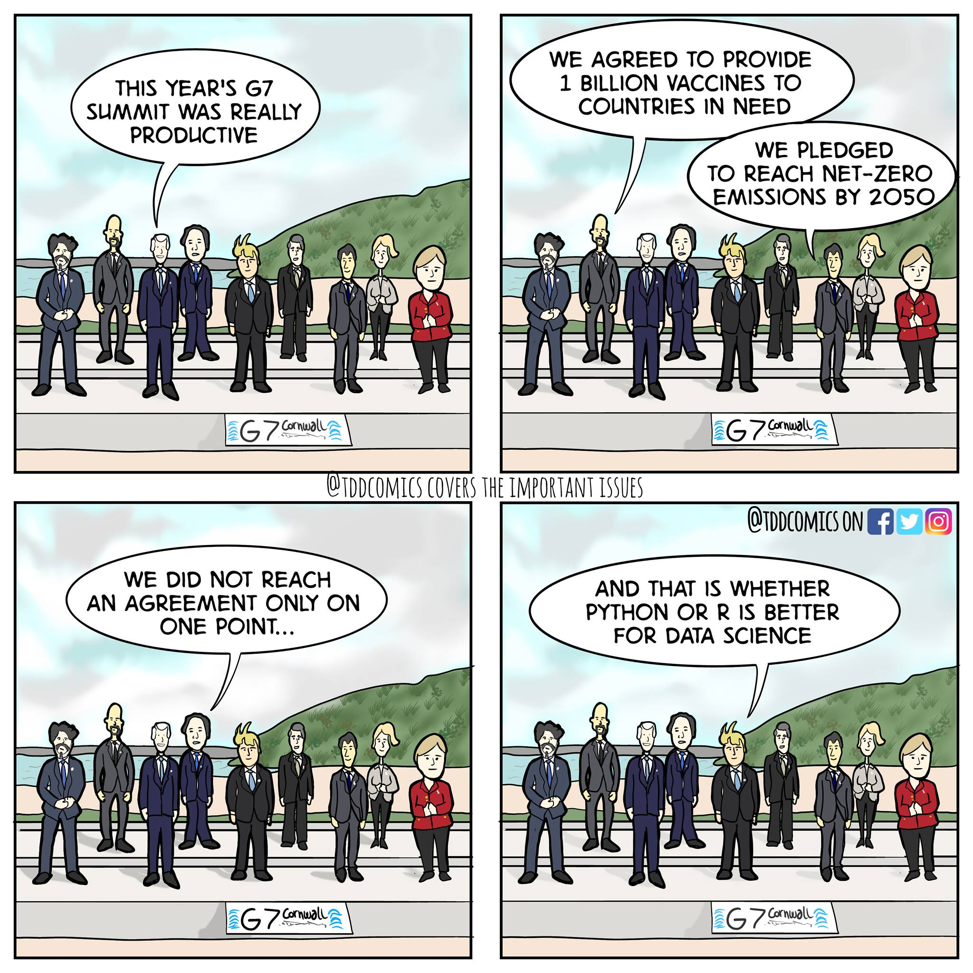
The answer:
both!

